Slide 1
My Experience with Wearables Data
Matt Barker - Knee Replacement Patient

Slide 2
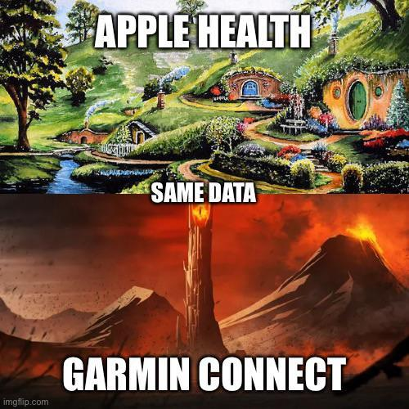

Slide 3
Initial experience with wearables
Basic Parkrun data
Added GPS
Added HR monitor
3rd Party apps - Garmin, Strava, Suunto, Training Peaks

Slide 4
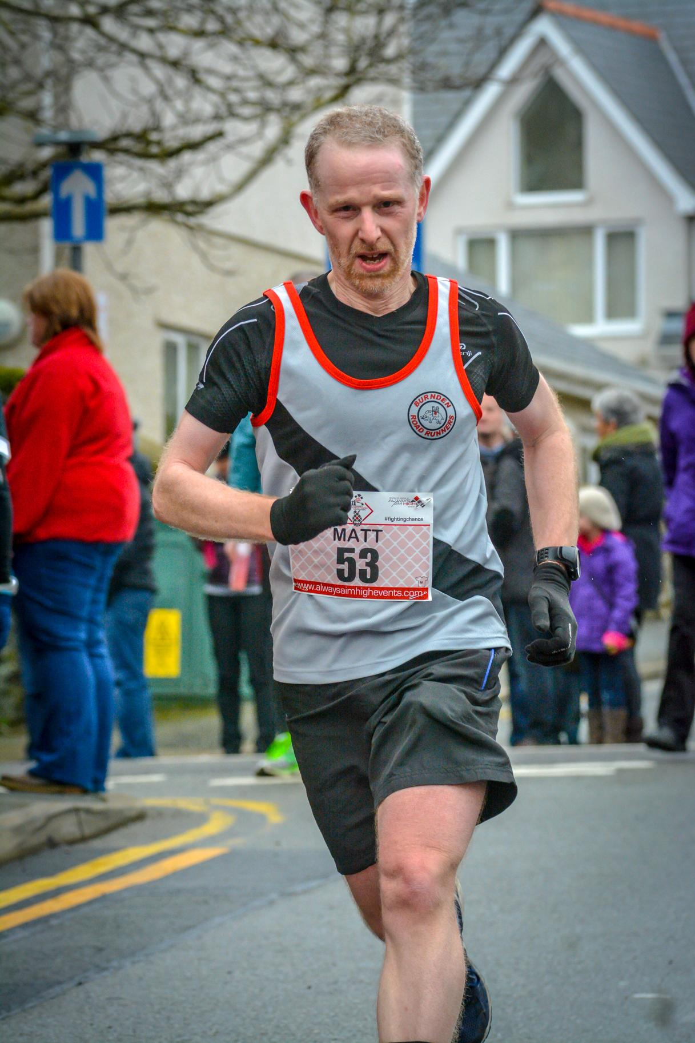

Slide 5
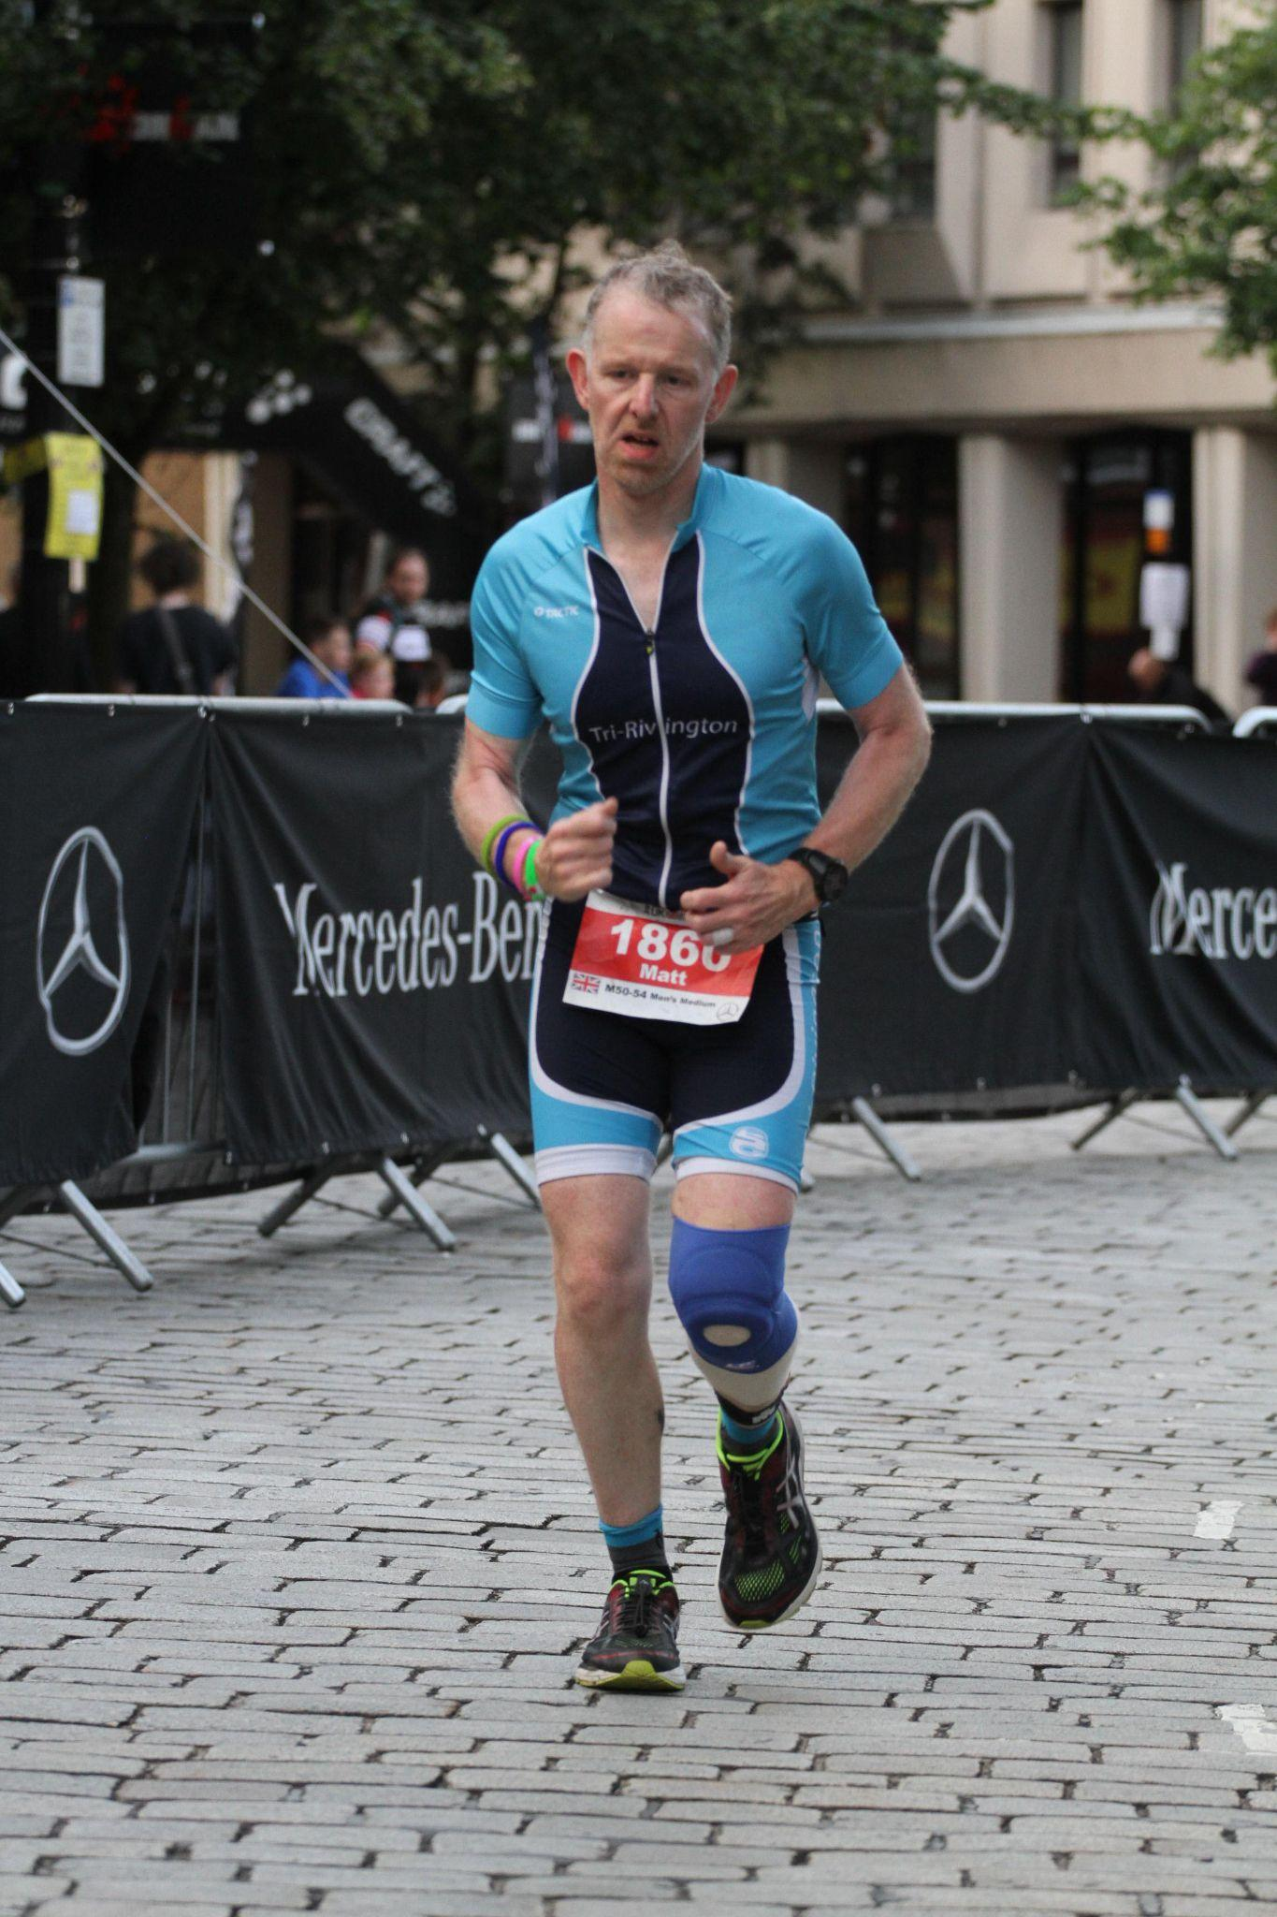

Slide 6
Knee problems begin
Forget the data - can I still run?
Is everything getting worse?
Is there any point wearing my watch and tracking my performance?
Can I see improvements post surgery?

Slide 7
A different perspective on data post surgery
Overall level of activity is more important
HR, HRV, sleep patterns
Health and wellbeing - is there something else I could be getting from the data being recorded?
Can I be motivated, reassured and warned of potential problems?

